Slide 1
HOTEL MANAGEMENT SYSTEM
TEAM MEMBERS: Namitha Mariam John Nikitha Sarah John Sneha Mary Abraham Nanadana Anukumar

Slide 2
Problem definition

Slide 3
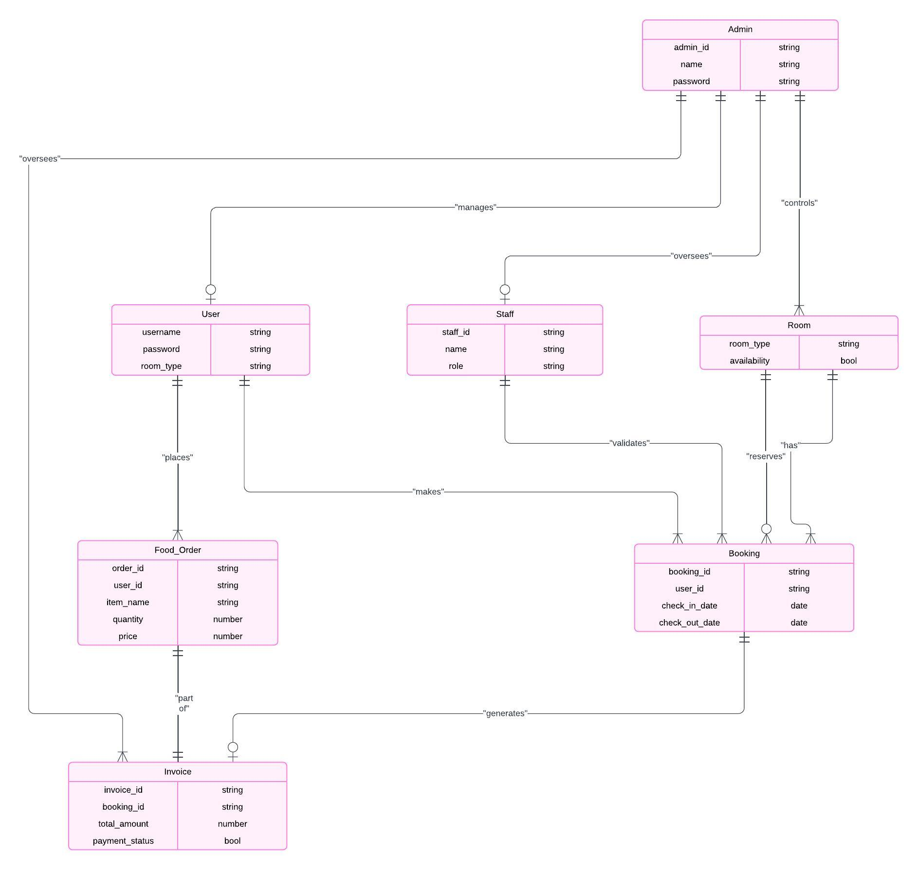
ER DIAGRAM

Slide 4
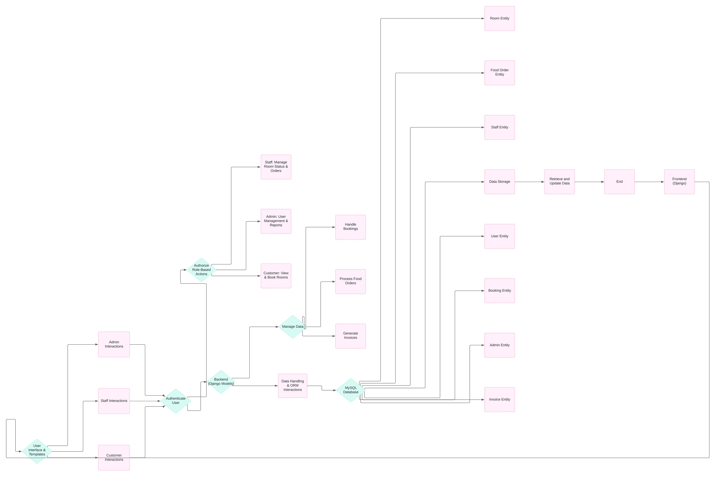
ARCHITECTURE DIAGRAM

